Slide 1

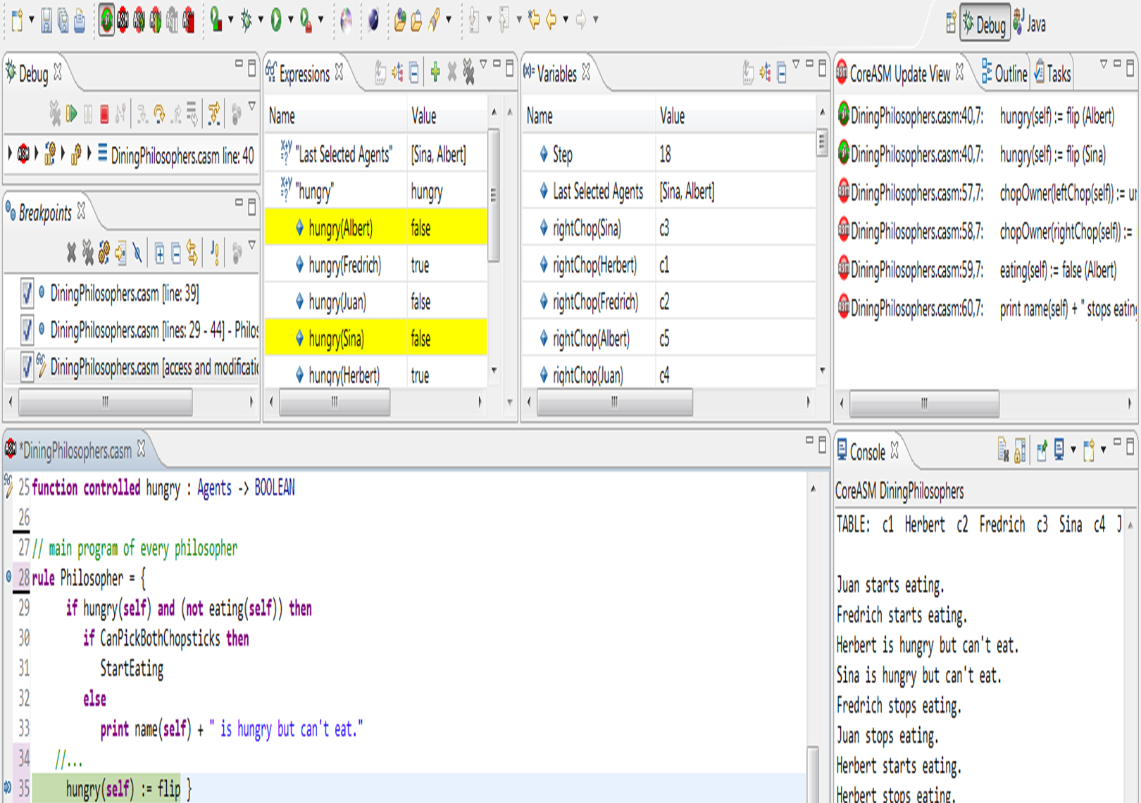
Alexander Raschke (Ulm), Egon Börger (Pisa)
Short Introduction to CoreASM

Slide 2
General Information
Developed by Farahbod Roozbeh et al. from 2005 to 2010 as PhD-thesis at Simon Fraser University, Vancouver, Canada.
Open-source tool (Java 1.7)
Source code (and documentation) available at https://github.com/coreasm
General Idea:
  minimal core and everything else is implemented as a plugin (even ConditionalRule (if-then-else) is a plugin!)
  Easy to extend and very flexible possibilities
  Set of plugins already shipped with installation
  (see user manual at https://github.com/CoreASM/
  coreasm.core/raw/master/org.coreasm.engine/rsc/doc/
  user_manual/CoreASM-UserManual.pdf)

Slide 3
CoreASM overview
CoreASM
Carma
command line interface
eclipse plugin(s)
project integration
editor
debugger
CoreASM engine
Parser, Interpreter, Abstract Storage, Schedulers
Basic plugins: Block, Conditional, Forall, …
Standard plugins: TurboASM, Signature (types), …
Additional plugins: Time, Scheduling, Math, …
Notes:
It is possible to use CoreASM engine via command line, but using eclipse is much more comfortable than the command line interface (syntax highlighting, quick-fixes, debugging, etc.)

Slide 4
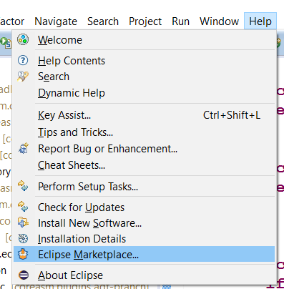
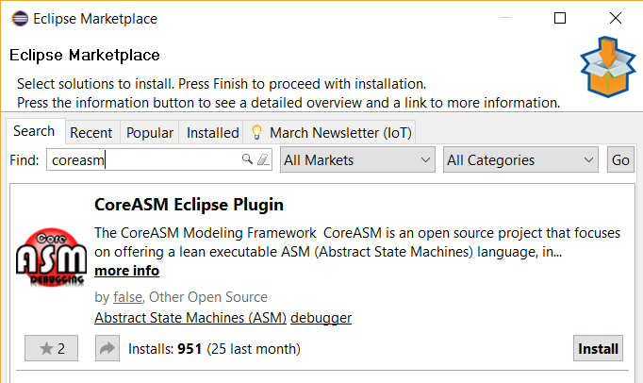
Installation
Easiest way to get CoreASM is via eclipse marketplace:
https://marketplace.eclipse.org/content/coreasm-eclipse-plugin

Slide 5
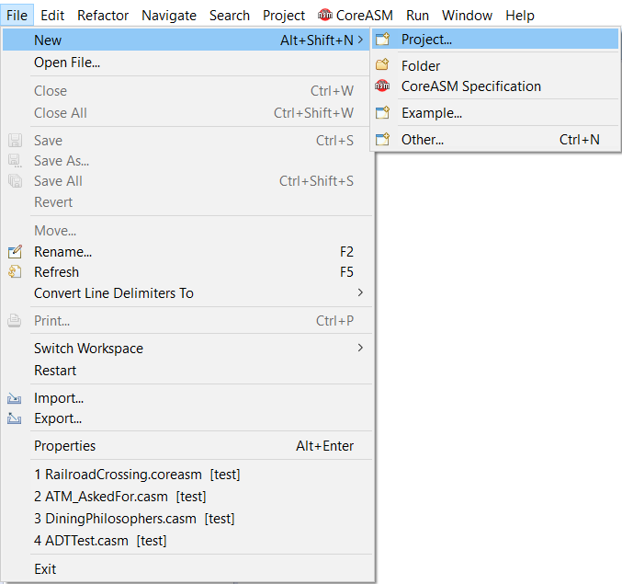
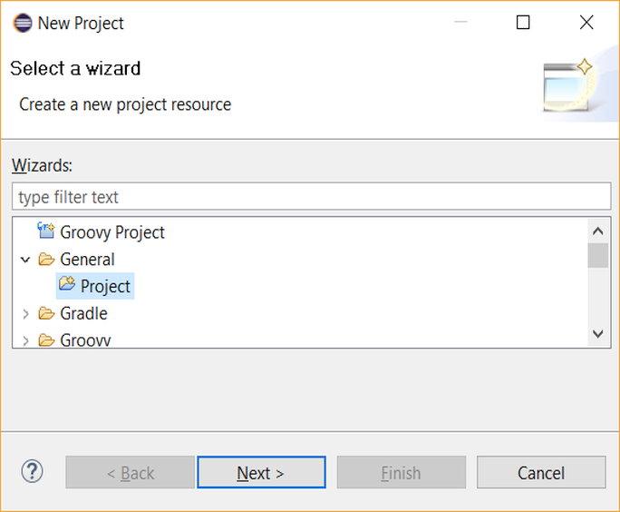
Getting started
First, you have to create a new (general) project in eclipse

Slide 6
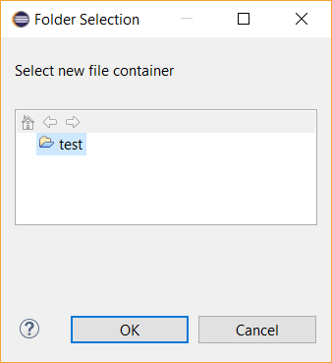
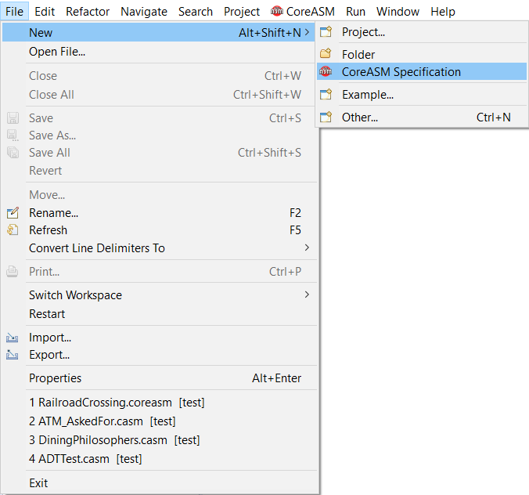
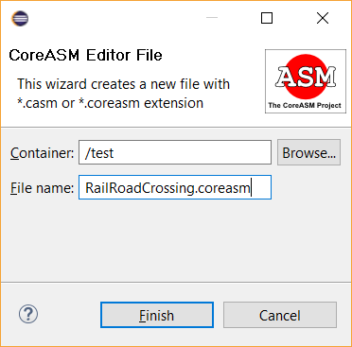
Getting started
In this new project container, you can create
a CoreASM specification

Slide 7
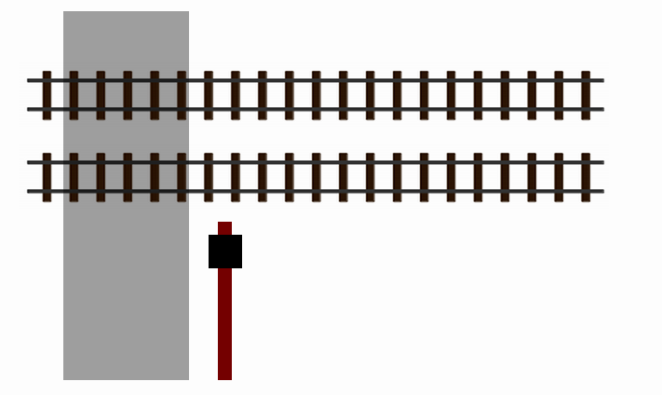
First example: Railroad crossing
d_{min} < x < d_{max}
TrackStatus:
crossing
coming
empty
waittime = d_{min} - d_{close}
d_{close}
deadline
d_{open}
Notes:
to show some possibilities of CoreASM, I borrow the railroad crossing example. Suppose, we have two railroad tracks and a street crossing them with an open gate. On the tracks, there are sensors at specific points. These sensors control the TrackStatus. Usually, the track is empty. If a train runs over the first sensor, the status becomes „coming“ till the train hits the second sensor, changing the track status to „crossing“. Once it is passed, the Trackstatus becomes „empty“ again.
The time span between coming and crossing sensor is at least d_min and at most d_max.
d_close denotes the time, the gate needs to close and d_open vice versa.
waittime is the time that can be waited at most, after the trackstatus changed to „coming“. The „deadline“ is the last point in time, when the gate should be closed to make sure, it is closed, when the train is crossing. After some time, when all tracks are still empty, the gate can be opened again.
The specification of the control system must fulfill a safety and a liveness property: When a train is in the crossing, the gate must be closed and the gate should be as long open as possible .
I‘ve also animated this scenario.

Slide 8

First example: Railroad crossing
TrackStatus:
coming
empty
deadline
Notes:
At first, the track is empty. Then a train approaches and activates the sensor „coming“.

Slide 9
First example: Railroad crossing
TrackStatus:
coming
deadline
Notes:
When the train continues, at the deadline, the gate is closed.

Slide 10
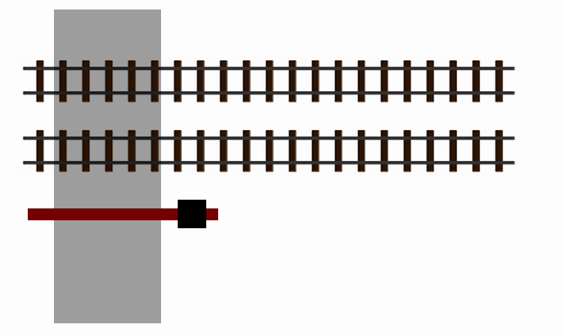
First example: Railroad crossing
TrackStatus:
crossing
coming
deadline
Notes:
Next, the train continues till the crossing, changing the track status again

Slide 11
First example: Railroad crossing
TrackStatus:
crossing
empty
deadline
Notes:
Once the Trackstatus is empty again (or a second train is still far enough away), the gate can be opened again.

Slide 12
First example: Railroad crossing
TrackStatus:
empty
deadline

Slide 13
From Mathematical Notation to Executable Specifications
E. Börger and R. Stärk. Abstract State Machines: A Method for High-Level System Design and Analysis. Springer, 2003
Notes:
A solution for this system can be found in the ASM book of Egon Börger:
The problem is, that although we have a precise mathematical notation, several details are not clear and must be mentioned separately, e.g.
Initialization of functions
Definition of WaitTime, currtime
Environment?

Slide 14
From Mathematical Notation to Executable Specifications
E. Börger and R. Stärk. Abstract State Machines: A Method for High-Level System Design and Analysis. Springer, 2003
Notes:
These details are explained in text which is fine for a theoretical view, but raises problems once it should be executed.
Thus, it is necessary, to define a precise syntax how these details can be entered.
One can see, the differences confine to some symbols and probably less abbreviations.
For the moment, just ignore the warnings.
More interesting is the initialization. Initialization in CoreASM is done by defining a starting rule via the keyword “init”. In this rule, all initialization can be done. In this case, some constants are set, and the trackstatus and the deadline for each track are defined as empty respectively, infinity.
In the following, programs akka rules are assigned to different asynchronous agents. Thus, the two controller for the tracks and for the gate run independently.
While agents must be defined as members of the special reserved universe “Agents”, their programs are assigned with a predefined function “program”. Universes can be seen as sets.
Finally, the program of the start agent is removed to make sure, the initialization rule is executed only once.
Executing the engine results in an error, because we are trying to apply a forall-construct on an undef-value. So, let’s define the tracks we have. → Schreib Definition ‘rein
universe Track = {track1, track2}
Now, it seems something is working, but we can’t see any output. Thus, we introduce another agent, printing the relevant state in each step.
At least it runs, but the undef value doesn’t make sense.
We have to define an enumeration value for the track and the gate state.
The behavior now is quite boring, cause no train is approaching. Although, we fulfilled the specification, for the execution it is very often helpful to model the environment as well.
For this purpose we use some nondeterministic choice together with a random number to decide the point of time, when a train on some of the tracks approaches and to model its movement.
Finally, we can improve the readability by defining derived functions for constants and declare the signature with types of all functions. Now, all warnings disappeared. The advantage of declaring functions is the same as in every other programming language: It allows for checking for typos. E.g. if I write by mistake “waittime” (mind: case sensitive!), then I’ll get a warning and a quick fix to replace the identifier.
For large specifications, the overview on the right hand side is helpful for faster navigation.
Once, the specifications get larger and larger, (we used CoreASM with specifications with round about 5000 lines!) the debugging component is quite helpful.
I can add a breakpoint at any line and once the line is hit, the interpretation is stopped and I can watch the function values, continue step by step, compare the update sets of the previous steps and even jump to a previous step and continue the execution from that point.
USE irgendwo noch erklären!

Slide 15
First example in CoreASM
Every specification must start with this keyword
CoreASM RailRoadCrossing
use StandardPlugins
use TimePlugin
use MathPlugin
This name is arbitrary;
it is recommended to choose a useful name
StandardPlugins is a collection of several plugins; it is recommended to use it in every specification
TimePlugin provides a monitored function "now" representing the current system time (incremented after every step)
MathPlugin is used to calculate with NUMBERs
Notes:
Up to now, we've shown you some best practices with CoreASM:
how to initialize, define agents and types, provide output and how to integrate the environment.
The work is supported by some features of CoreASM like syntax highlighting, code completion, quick fixes and the debugging component.

Slide 16
rules are introduced with this keyword
don't miss the "par"/"endpar" keywords!
Intendation is not recognized!
rule TrackControl =
par
forall x in Track do
par
SetDeadline(x)
SignalClose(x)
ClearDeadline(x)
endpar
SignalOpen
endpar
many rules have a "do" at the end!
"element of" is translated to "in"
"where" for local definitions is not supported, hence all definitions are global
no semicolons at the end of lines

Slide 17
logical operators are "and", "or", "not"
rule SetDeadline(x) =
if trackStatus(x) = coming and deadline(x) = infinity then
deadline(x) := now + waitTime
rule SignalClose(x) =
if now >= deadline(x) and now <= deadline(x) + span then
dir := close
rule ClearDeadline(x) =
if trackStatus(x) = empty and deadline(x) < infinity then
deadline(x) := infinity
rule SignalOpen =
if dir = close and safeToOpen then
dir := open
derived safeToOpen =
forall t in Track holds
trackStatus(t) = empty or (now + dopen) < deadline(t)
defined in MathPlugin
defined in TimePlugin
UpdateRule is ":="
comparison is "="
"safeToOpen" is a derived function, not a rule
this forall is an expression and not a rule; that's why we used "holds" instead of "do"

Slide 18
rule GateControl =
par
if dir = open and gateState = closed then gateState := opened
if dir = close and gateState = opened then gateState := closed
endpar
The rule "Switch" is not predefined in CoreASM.
Thus, we simulate its behaviour.
The conditional rule is "if … then … else …".
If you skip the "else"-part, it is treated as if you write "… else skip".

Slide 19
Important part: Initialization
You cannot run the specification, yet, because you have not defined an init rule:
init InitRule
rule InitRule = par
TrackControl
GateControl
endpar
With the "init"-keyword you specify one "start"-rule that is executed at each step
You can write the "par"-keyword also at the end of a line

Slide 20
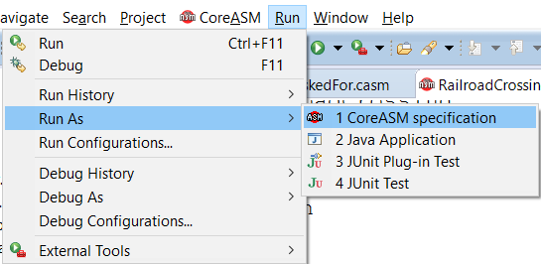
Run the specification
Error message:
Cannot perform a 'forall' over undef. Forall domain must be an enumerable element. (check C:\...\RailroadCrossing.coreasm:100,15)
in TrackControl()
called from InitRule()

Slide 21
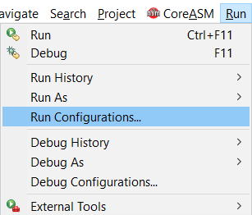
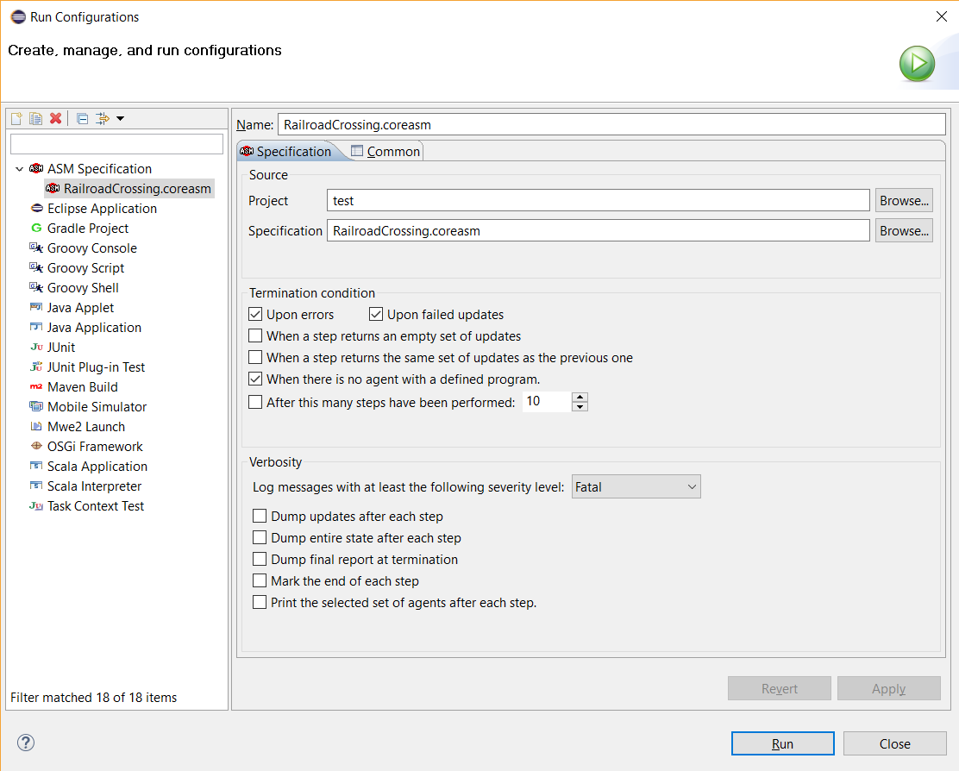
Change the "Run configuration"

Slide 22
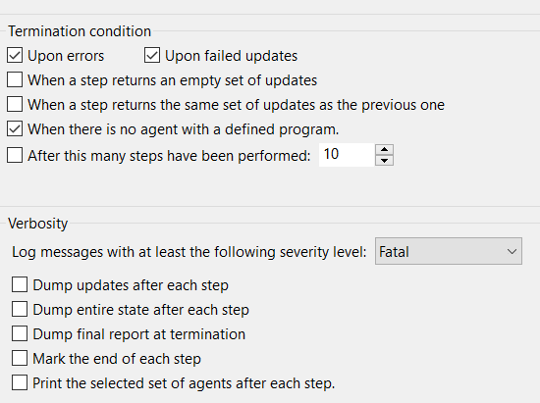
Change the "Run configuration"
#--- end of step 1

Slide 23
A closer look at the error message
Cannot perform a 'forall' over undef. Forall domain must be an enumerable element. (check C:\...\RailroadCrossing.coreasm:100,15)
in TrackControl()
called from InitRule()
So far, no types or controlled function definitions at all
every identifier used in the specification is initialized with "undef"
possible types in CoreASM (with plugins)
  boolean
  universe (a special built-in kind of set)
  enumeration
  number
  string
  collections (set, bag, list, queue, stack, map)

Slide 24
Remove "undef"s by defining/initializing all identifiers
definition of universes as sets
universe Track = {track1, track2}
enum TrackStatus = {empty, coming, crossing}
enum GateState = {opened, closed}
enum Direction = {open, close}
rule InitRule = par
// initialize all constants
dmin := 5000
dmax := 10000
dopen := 2000
dclose := 2000
waitTime := 3000
dcrossing := 3000
span := 500
gateState := opened
startTime := now
enumerations do not define sets, but possible values of a location
line comments with "//"
block comments with "/*.. */"
// initialize the track sensors
forall t in Track do
par
trackStatus(t) := empty
deadline(t) := infinity
passingTime(t) := 0
endpar
TrackControl
GateControl
endpar // of the InitRule

Slide 25
Still errors due to parallelism
Initialization is performed in parallel ➔ update with initial state not yet available when "TrackControl" or "GateControl" are executed.
Typical pattern to ensure initialization executed only once and at the beginning:
universe Agents = {trackController, gateController}
universe Track = {track1, track2}
rule InitRule = par
// initialize all constants
…
// initialize the track sensors
…
program(trackController) := @TrackControl
program(gateController) := @GateControl
program(self) := undef
endpar
predefined set of agents (+ init-rule)
assignment of programs (= rules) to agents. program is a predefined function on the set of Agents.
@<rulename> refers to the rule itself (not only the name)
The program of the initialization-agent is removed (set to undef). "self" is a predefined keyword to specify the currently executing agent

Slide 26

Running, but… how to stop?
about box
stop engine
resume (after pausing)
very simple (and outdated help)
pause engine

Slide 27
Running, but…
… no output is produced, except (if you made the changes in the run configuration):
#--- end of step 1
#--- end of step 2
#--- end of step 3
…
Solution: provide an observer
rule ObserverProgram =
seqblock
print "Time: " + ((now - startTime) / 1000) + " seconds"
forall t in Track do
print "Track " + t + " is " + trackStatus(t)
print "Gate is " + gateState
print ""
endseqblock
Don't forget to add "observer" to the set of Agents and to assign this rule as program for this agent!
The TurboASM rule "seqblock" executes the rules inside sequentially.
"print" uses Java "toString"-method to generate string for arbitrary types for console output, followed by a newline

Slide 28
Running, but…
… always the same output is produced
Solution: provide an environment simulating the movement of a train:
rule EnvironmentProgram =
choose t in Track do par
if trackStatus(t) = empty then
if random < 0.001 then par
trackStatus(t) := coming
passingTime(t) := now + dmin
endpar
if trackStatus(t) = coming then
if passingTime(t) < now then par
trackStatus(t) := crossing
passingTime(t) := now + dcrossing
endpar
if trackStatus(t) = crossing then
if passingTime(t) < now then
trackStatus(t) := empty
endpar
"choose" chooses an arbitrary element of the given set
"random" provides a number x with 0 <= x < 1
Again, don't forget to add "environment" to the set of Agents and to assign this rule as program for this agent!

Slide 29
Best practices
don't allow undefined identifiers
define function types
option Signature.NoUndefinedId strict
function gateState: -> GateState initially opened
function trackStatus: Track -> TrackStatus
function deadline: Track -> NUMBER
function dir : -> Direction initially open
function passingTime: Track -> NUMBER
function startTime: -> NUMBER
derived dmin = 5000
derived dmax = 10000
derived dopen = 2000
derived dclose = 2000
derived waitTime = dmin - dclose
derived dcrossing = 3000
derived span = 500
define initial values (where possible) at the declaration
Define constants as derived functions

Slide 30
From mathematical notation to executable specification
Roundup:
  Initialization
  definition of agents, disabling of init agent
  type definitions optional
  output with “print”
  modeling of environment
Some more features making the development easier:
  syntax highlighting
  code completion
  quick fixes
  debugging
  update set comparison

Slide 31
Further documentation
Please read the User manual to get familiar with the language:
https://github.com/CoreASM/coreasm.core/raw/master/org.coreasm.engine/rsc/doc/user_manual/CoreASM-UserManual.pdf
Please read the Debugging manual to get familiar with the debugging possibilities:
https://github.com/CoreASM/coreasm.core/raw/master/org.coreasm.eclipse/rsc/doc/CoreASM_Eclipse_Debugger_Manual.pdf
Please read the Design documentation, if you want to know details about how CoreASM works or if you want to contribute to this project:
https://github.com/CoreASM/coreasm.core/raw/master/org.coreasm.engine/rsc/doc/CoreASM-DesignDocumentation.pdf

Slide 32
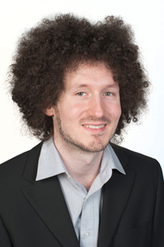

Where to get it
eclipse marketplace (http://marketplace.eclipse.org/search/site/coreasm)
eclipse update site
(http://webcoreasm.informatik.uni-ulm.de/coreasm-repository/)
Sources on github
(https://github.com/coreasm)
If you have any question, don't hesitate to contact us via coreasm@uni-ulm.de
Michael Stegmaier
Alexander Raschke

Slide 33

Copyright Notice
It is permitted to (re-) use these slides under the CC-BY-NC-SA licence
https://creativecommons.org/licenses/by-nc-sa/4.0/
i.e. in particular under the condition that
the two original authors are mentioned
modified slides are made available under the same licence
the (re-) use is not commercial

